Slide 1
Register Transfer Language
The operations executed on data stored in registers are called micro-operations.
The symbolic notation used to describe the micro-operation transfers among registers is called Register transfer language.
The term Register transfer implies the availability of hardware logic circuits to perform stated micro-operation.

Slide 2
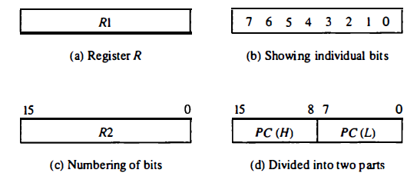
Register Transfer
Computer registers are designated by capital letters to denote the function of register.

Slide 3
Register Transfer
The information transfer from one register to another register is designated in symbolic form.
For example: R2 ←R1 denotes a transfer of the content of register R1 into register R2.
The above Register transfer under a predetermined control condition can be represented by an if-then statement :
If (P=1) Then R2 ←R1
where P is a control signal generated in the control section.
It can be written as P: R2 ←R1

Slide 4
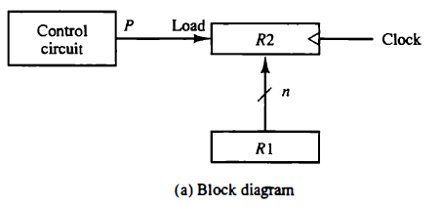
Register Transfer

Slide 5
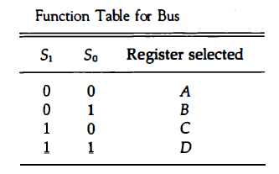
Bus Transfer
The efficient way for transferring information between registers in a multiple-register configuration is a common system bus.
One way of constructing a common bus system is with multiplexers which is shown in fig.

Slide 6
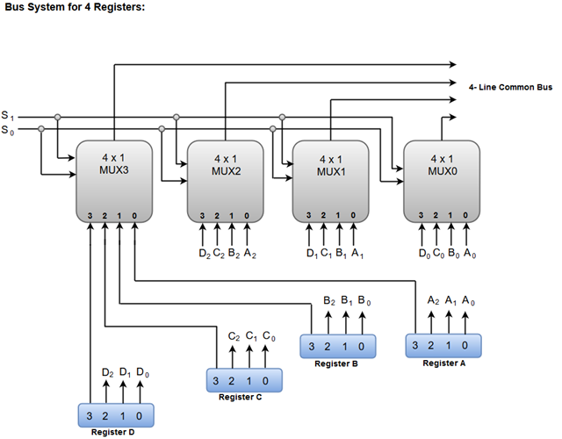
Bus Transfer

Slide 7
Memory Transfer
Consider a memory unit that receives the address from a register called address register(AR) and data transferred to another register called data register(DR).
The read operation can be symbolized by
Read : DR ← M[AR]
The write operation transfers the content of a data register like R1 to memory word M selected by address.
Write: M[AR] ← R1

Slide 8
Question
Question:
A digital Computer has common bus system for 16 register of 32 bits each. How Many MUX are needed, What is the size of the MUX. How Many selection lines are there.

Slide 9
Micro-Operation
Computer system micro-operations are of four types:
  Register transfer micro-operations
  Arithmetic micro-operations
  Logic micro-operations
  Shift micro-operations

Slide 10
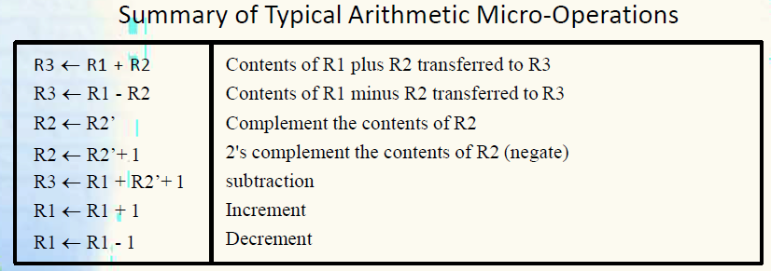
Arithmetic Micro-operations

Slide 11
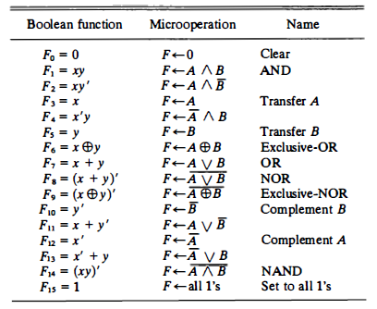
Logical Micro-operations

Slide 12
Shift Micro-operations
R ← shl R (Shift-left register R)
R ←shr R (Shift-right register R)
R ←cil R (Circular shift-left register R)
R ← cir R (Circular shift-right register R)
R ← ashl R (Arithmetic shift-left R)
R ← ashr R (Arithmetic shift-right R)

